Slide 1
COMS E6998: Microservices and Cloud Applications Lecture 9: CAP Theorem, Database Models, XYZ-Scaling, 12 Factor Apps, Graph DB, Redis
Dr. Donald F. Ferguson
dff9@columbia.edu

Slide 2
Comments Questions

Slide 3
Databases Consistency CAP Theorem Database Models

Slide 4
ACID Databases (https://www.linkedin.com/pulse/what-acid-properties-database-aseem-jain/)

Slide 5
CAP Theorem
Consistency
Every read receives the most recent write or an error.
Availability
Every request receives a (non-error) response – without guarantee that it contains the most recent write.
Partition Tolerance
The system continues to operate despite an arbitrary number of messages being dropped (or delayed) by the network between nodes

Slide 6
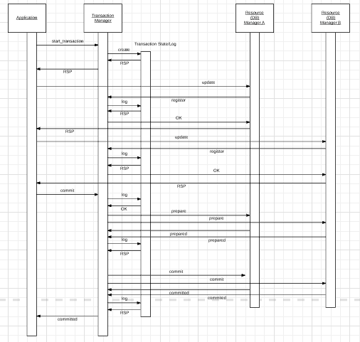
Two Phase Commit
“In transaction processing, databases, and computer networking, the two-phase commit protocol (2PC) is a type of atomic commitment protocol (ACP). It is a distributed algorithm that coordinates all the processes that participate in a distributed atomic transaction on whether to commit or abort (roll back) the transaction (it is a specialized type of consensus protocol). The protocol achieves its goal even in many cases of temporary system failure (involving either process, network node, communication, etc. failures), and is thus widely used” (www.wikipedia.org)
Note: This sequence diagram omits some steps.
Uses:
ACID, especially consistency, for data in different databases/services.
Modified approach is required to strictly achieve consistency and availability for replicated data,

Slide 7
Availability and Replication
There are two basic patterns
Active/Passive
All requests go to master during normal processing.
Updates are transactionally queued for processing at passive backup.
Failure of master
Routes subsequent requests to backup.
Backup must process and commit updates before accepting requests.
Active/Active
Both environments process requests.
Some form of distributed transaction commit required to synchronize updates on both copies.
Multi-system communication to guarantee consistency is the foundation for tradeoffs in CAP.
The system can be CAP if and only iff
There are never any partitions or system failures
Which is unrealistic in cloud/Internet systems.

Slide 8
Consistency Models
STRONG CONSISTENCY: Strong consistency is a consistency model where all subsequent accesses to a distributed system will always return the updated value after the update.
WEAK CONSISTENCY: It is a consistency model used in distributed computing where subsequent accesses might not always be returning the updated value. There might be inconsistent responses.
EVENTUAL CONSISTENCY: Eventual consistency is a special type of weak consistency method which informally guarantees that, if no new updates are made to a given data item, eventually all accesses to that item will return the last updated value.

Slide 9
Eventual Consistence
Availability and scalability via
Multiple, replicated data stores.
Read goes to “any” replica.
PUT/POST/DELETE
Goes to any replica
Change propagate asynchronously
GET may not see the latest value if the update has not propagated to the replica.
There are several algorithms for conflict resolution
Detect and handle in application.
Clock/change vectors/version numbers
… …
get
put

Slide 10
Core Data Models (http://blog.nahurst.com/visual-guide-to-nosql-systems)
In addition to CAP configurations, another significant way data management systems vary is by the data model they use: relational, key-value, column-oriented, or document-oriented (there are others, but these are the main ones).
Relational systems are the databases we've been using for a while now. RDBMSs and systems that support ACIDity and joins are considered relational.
Key-value systems basically support get, put, and delete operations based on a primary key.
Column-oriented systems still use tables but have no joins (joins must be handled within your application). Obviously, they store data by column as opposed to traditional row-oriented databases. This makes aggregations much easier.
Document-oriented systems store structured "documents" such as JSON or XML but have no joins (joins must be handled within your application). It's very easy to map data from object-oriented software to these systems.

Slide 11
Core Data Models (http://blog.nahurst.com/visual-guide-to-nosql-systems)
In addition to CAP configurations, another significant way data management systems vary is by the data model they use: relational, key-value, column-oriented, or document-oriented (there are others, but these are the main ones).
Relational systems are the databases we've been using for a while now. RDBMSs and systems that support ACIDity and joins are considered relational.
Key-value systems basically support get, put, and delete operations based on a primary key.
Column-oriented systems still use tables but have no joins (joins must be handled within your application). Obviously, they store data by column as opposed to traditional row-oriented databases. This makes aggregations much easier.
Document-oriented systems store structured "documents" such as JSON or XML but have no joins (joins must be handled within your application). It's very easy to map data from object-oriented software to these systems.
There are also graph databases, which we will cover.

Slide 12
Database Models
Consistent, Available (CA) Systems have trouble with partitions and typically deal with it with replication. Examples of CA systems include:
Traditional RDBMSs like Postgres, MySQL, (relational)
Vertica (column-oriented)
Aster Data (relational)
Greenplum (relational)
Consistent, Partition-Tolerant (CP) Systems have trouble with availability while keeping data consistent across partitioned nodes. Examples of CP systems include:
BigTable (column-oriented/tabular)
Hypertable (column-oriented/tabular)
HBase (column-oriented/tabular)
MongoDB (document-oriented)
Terrastore (document-oriented)
Redis (key-value)
Scalaris (key-value)
MemcacheDB (key-value)
Berkeley DB (key-value)
Available, Partition-Tolerant (AP) Systems achieve "eventual consistency" through replication and verification. Examples of AP systems include:
DynamoDB (key-value)
Voldemort (key-value)
Tokyo Cabinet (key-value)
KAI (key-value)
Cassandra (column-oriented/tabular)
CouchDB (document-oriented)
SimpleDB (document-oriented)
Riak (document-oriented)
http://blog.nahurst.com/visual-guide-to-nosql-systems

Slide 13
Database Models
Consistent, Available (CA) Systems have trouble with partitions and typically deal with it with replication. Examples of CA systems include:
Traditional RDBMSs like Postgres, MySQL, (relational)
Vertica (column-oriented)
Aster Data (relational)
Greenplum (relational)
Consistent, Partition-Tolerant (CP) Systems have trouble with availability while keeping data consistent across partitioned nodes. Examples of CP systems include:
BigTable (column-oriented/tabular)
Hypertable (column-oriented/tabular)
HBase (column-oriented/tabular)
MongoDB (document-oriented)
Terrastore (document-oriented)
Redis (key-value)
Scalaris (key-value)
MemcacheDB (key-value)
Berkeley DB (key-value)
Key-Value versus Document can be a little confusing.
Many, if not most, Key-Value stores hold documents.
The difference is
Not in what the data store holds
But how you can query and find it.
Key-Value store finds data by key values explicitly associated with a document.
Document stores allow queries on the fields/values in the document, similar to a relational WHERE on columns.
Available, Partition-Tolerant (AP) Systems achieve "eventual consistency" through replication and verification. Examples of AP systems include:
DynamoDB (key-value)
Voldemort (key-value)
Tokyo Cabinet (key-value)
KAI (key-value)
Cassandra (column-oriented/tabular)
CouchDB (document-oriented)
SimpleDB (document-oriented)
Riak (document-oriented)
http://blog.nahurst.com/visual-guide-to-nosql-systems

Slide 14
Some Queries
MongoDB Query
db.inventory.find( { status: "A", $or: [ { qty: { $lt: 30 } }, { item: /^p/ } ]} )
Finds all documents in the collection wherthe status equals "A" and either qty is less than ($lt) 30 or item starts with the character ”p”
Redis
SADD product:category:1 5 10 // Put product IDs 5 and 10 in category 1.
SMEMBERS product:category:2 // Get the IDs of all products in category 2.
DynamoDB
var params = { TableName : "Movies", KeyConditionExpression: "#yr = :yyyy", ExpressionAttributeNames:{ "#yr": "year" }, ExpressionAttributeValues: { ":yyyy":1985 } };
Dynamo DB
Queries on keys
Scans on values

Slide 15
Columnar (Relational) Database (https://www.dbbest.com/blog/column-oriented-database-technologies/)
Columnar and Row are both
Relational
Support SQL operations
But differ in data storage
Row keeps row data together in blocks.
Columnar keys column data together in blocks.
This determines performance for different types of query, e.g.
Columnar is extremely powerful for BI scenarios
Aggregation ops, e.g. SUM, AVG
PROJECT (do not load all of the row) to get a few columns
Row is powerful for OLTP. Transaction typically create and retrieve
One row at a time
All the columns of a single row.

Slide 16
Graph Database
Exactly what it sounds like
Two core types
Node
Edge (link)
Nodes and Edges have
Label(s) = “Kind”
Properties (free form)
Query is of the form
p1(n)-p2(e)-p3(m)
n, m are nodes; e is an edge
p1, p2, p3 are predicates on labels

Slide 17
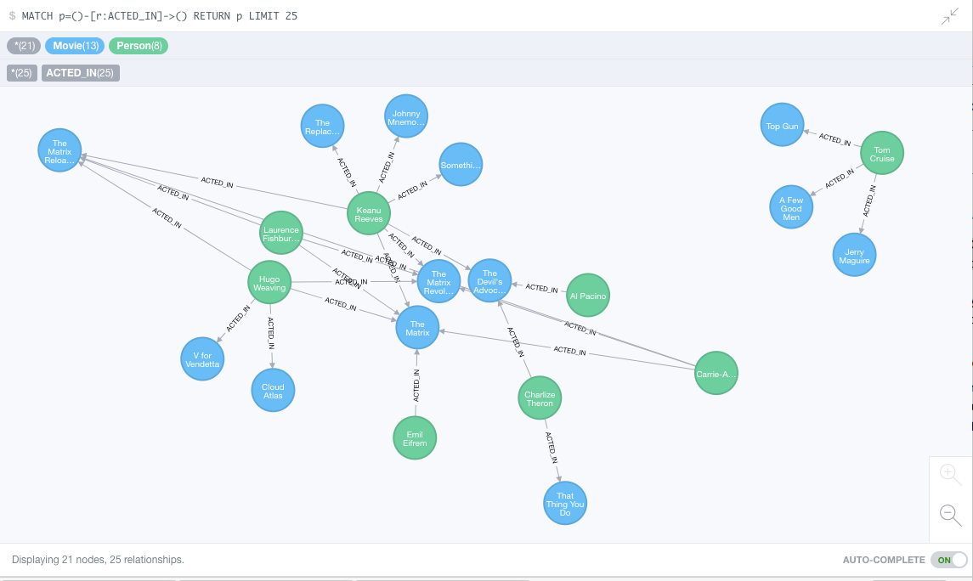
Neo4J Graph Query

Slide 18
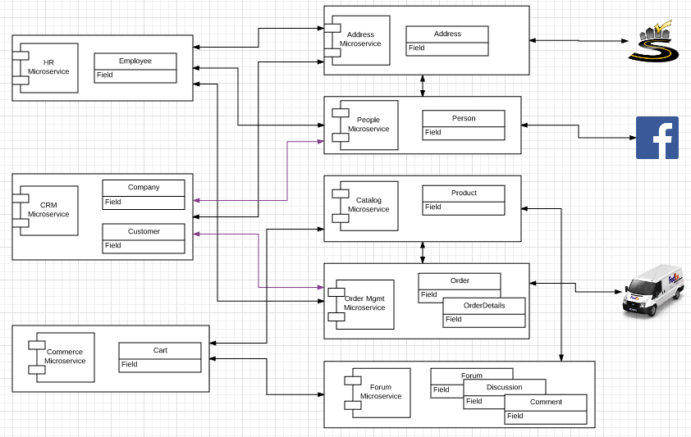
Thanks, but Why?
The initial idea was
DynamoDB for the forum
Neo4J to track/query
Who bought what?
Who has bought things similar to whom?
Who commented on what?
etc.
Use Redis to optimize
Idempotency
Etag
But
we do not have enough time to do in context of solution.
Will have to do smaller scenarios and use cases.

Slide 19
Microservice XYZ Scaling

Slide 20
Scaling Microservices

Slide 21
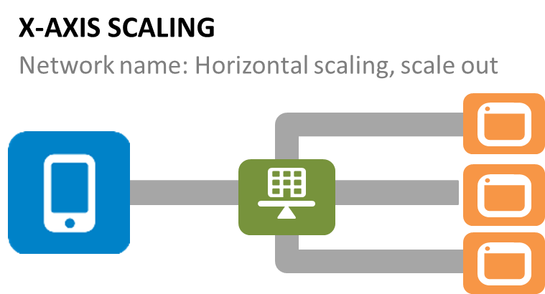
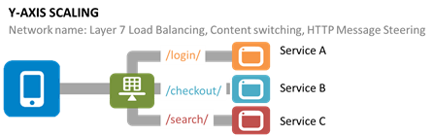
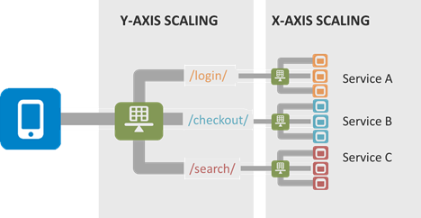
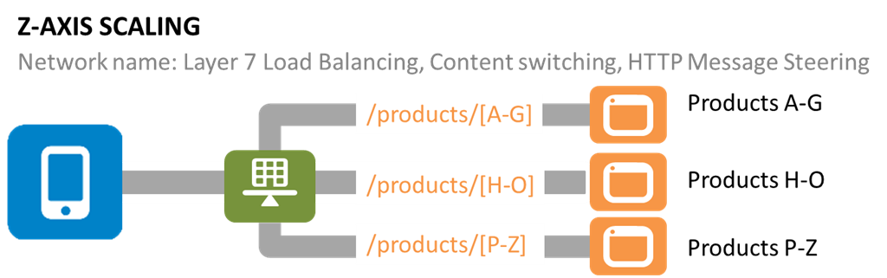
Microservice Scaling
https://devcentral.f5.com/articles/the-art-of-scale-microservices-the-scale-cube-and-load-balancing

Slide 22
Microservice Scaling
X-Axis (Horizontal Scaling) assumes
Each instance has equal access to data ➔
Highly scalable database in some scenarios.
And is the assumed model for
Lambda functions
Elastic BeanStalk
This is hard to achieve for scenarios like
ETag
Idempotentcy tokens
https://devcentral.f5.com/articles/the-art-of-scale-microservices-the-scale-cube-and-load-balancing

Slide 23
Redis (Memcache), ETag, Idempotency
ETag
Store {URL, ETag} on GET cache miss.
Invalidate tag on any PUT, POST
Fail safe: If any doubt, e.g. partition, error, …, treat as a conflict.
Idempotency
Check for duplicate, and create if not exists.
Fail safe: do not process a request if any doubt.

Slide 24
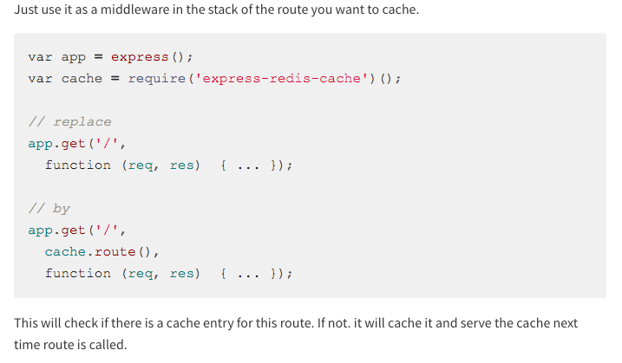
Similar to express-redis-cache (https://www.npmjs.com/package/express-redis-cache)

Slide 25
12 Factor Applications
https://12factor.net/
https://www.slideshare.net/bifer/twelve-factor-apps

Slide 26
The 12 Factors
I. Codebase One codebase tracked in revision control, many deploys II. Dependencies Explicitly declare and isolate dependencies III. Config Store config in the environment IV. Backing Services Treat backing services as attached resources V. Build, release, run Strictly separate build and run stages VI. Processes Execute the app as one or more stateless processes
VII. Port binding Export services via port binding VIII. Concurrency Scale out via the process model IX. Disposability Maximize robustness with fast startup and graceful shutdown X. Dev/prod parity Keep development, staging, and production as similar as possible XI. LogsTreat logs as event streams XII. Admin processes Run admin/management tasks as one-off processes

Slide 27
See PDF

